Slide 1
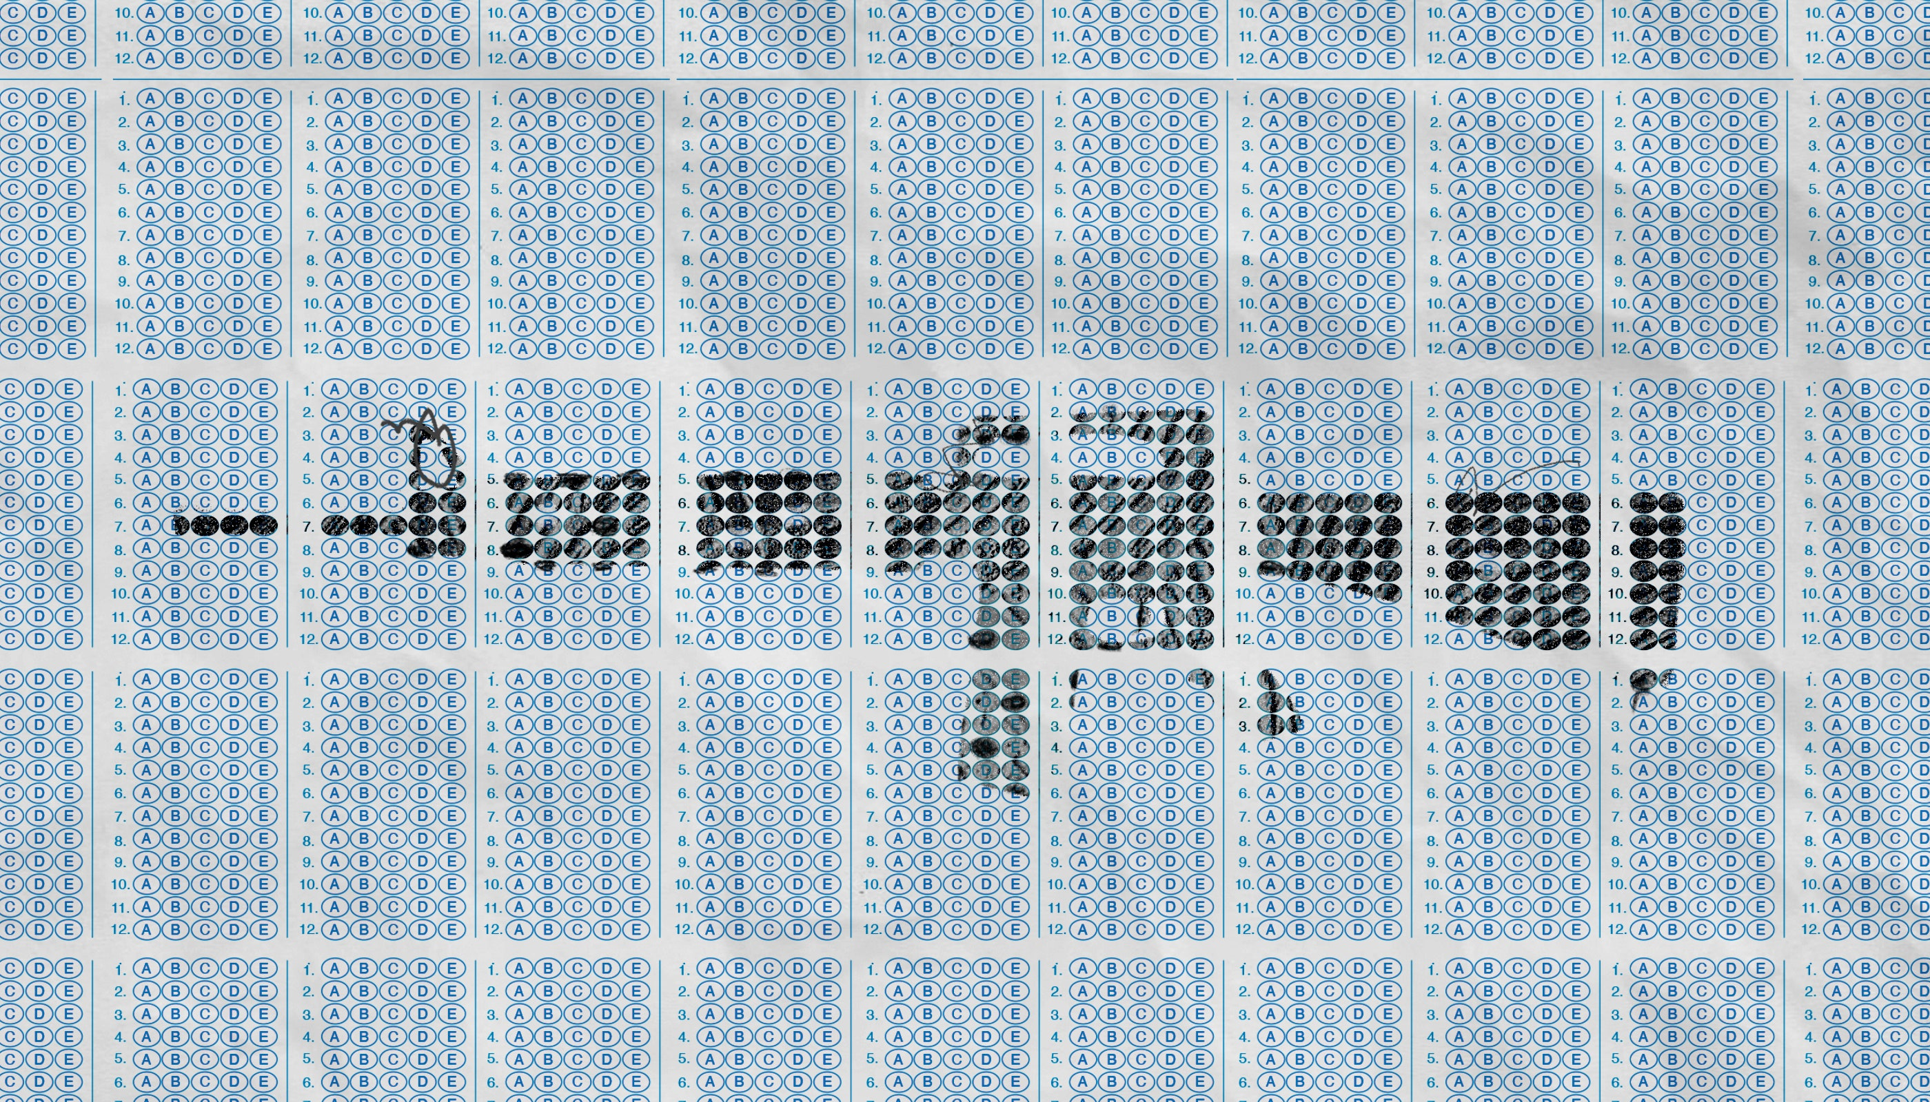
School Mass Shooting Twitter Sentiment Analysis: Uvalde vs Parkland
By: Nicholas McFadden

Slide 2
Research Objectives
The objective is to analyze how the public sentiment around the discussion of school mass shootings (specifically from Twitter) has changed
Analysis will be conducted on the recent Robb Elementary shooting in Uvalde, Texas and Stoneman Douglas High School in Parkland, Florida
1000 Tweets were pulled for each event
Tweets were taken from the day of the event and up to two weeks after the event

Slide 3
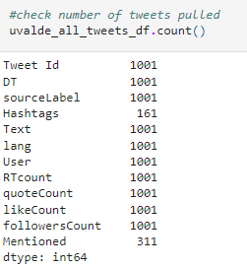
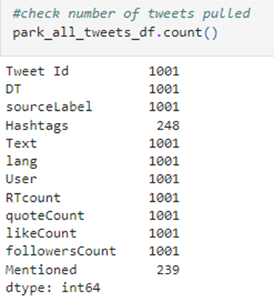
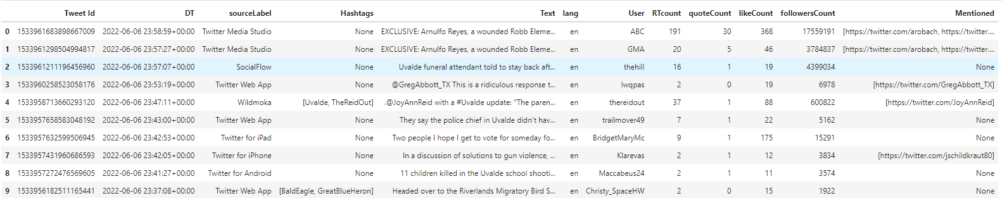
About the Data
Queries:
Keywords and Hashtags (i.e. uvalde, #uvalde,etc)
Must have some engagement (likes, retweets,etc)
Likes >= 10
Time: two weeks post event

Slide 4
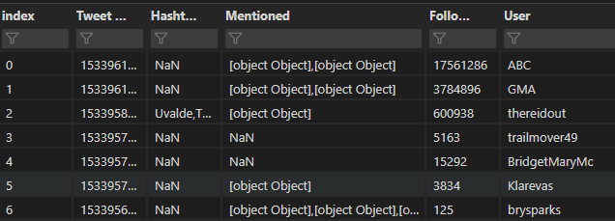
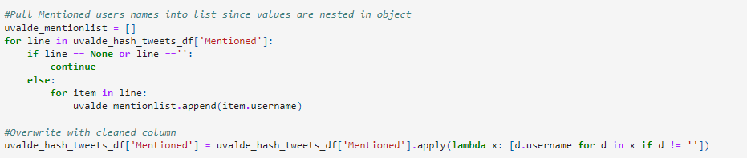
Data cleansing
Tweets were pulled into specific data frames for analysis to be more manageable
Some tweet fields were objects and/or nested lists that needed to be extracted/flattened
Many None type values that were filled with blanks

Slide 5
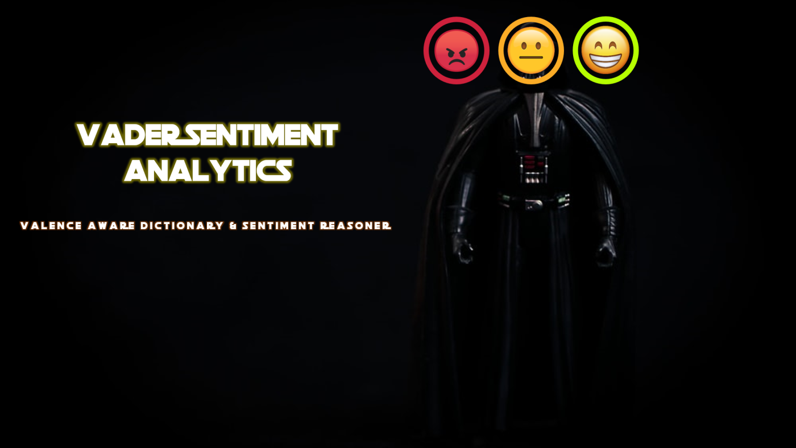
VADER Sentiment Intensity Analyzer
“VADER is a lexicon and rule-based tool optimized for classifying sentiments expressed in user-generated text in social media. The rules it utilizes are heuristics derived from a manual review of a set of tweets by multiple independent human judges. The authors have also incorporated many features that are not found in other sentiment analyzers, such as punctuation, capitalization, slangs, emoticons, and degree modifiers. The results produced by VADER are in the form of sentiment polarity (positive vs. negative), and a numeric sentiment intensity score”
“To preprocess these data, we used Python’s Natural Language Toolkit (NLTK). First, a regular expression (Regex) in Python was run to detect and discard tweets special characters, such as URLs (“http://url”), retweet (RT), user mention (@), and unwanted punctuation. Because hashtags (#) often explain the subject of the tweet and contain useful information related to the topic of the tweet, they are added as a part of the tweet, but the “#” symbol was removed. “
Source:
http://www.iaeng.org/publication/IMECS2019/IMECS2019_pp12-16.pdf
https://towardsdatascience.com/are-you-scared-vader-understanding-how-nlp-pre-processing-impacts-vader-scoring-4f4edadbc91d

Slide 6
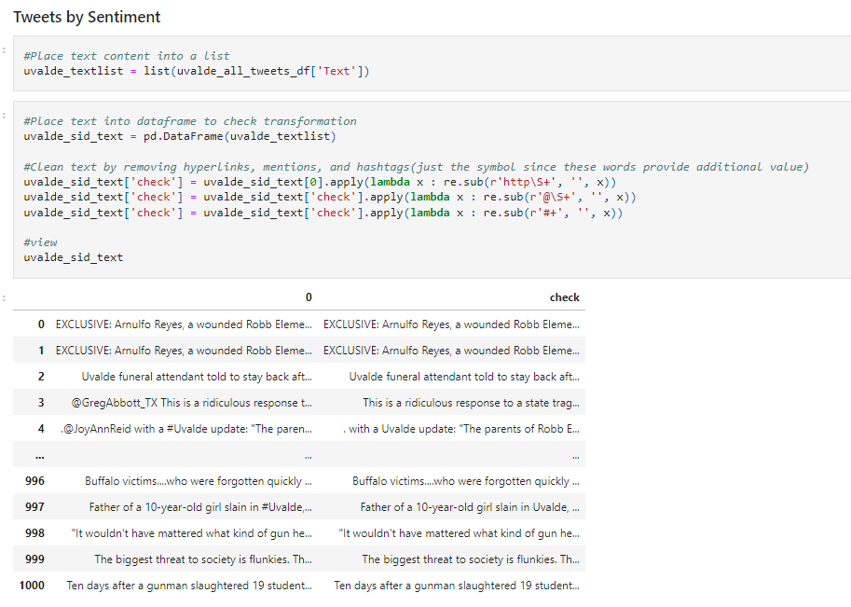
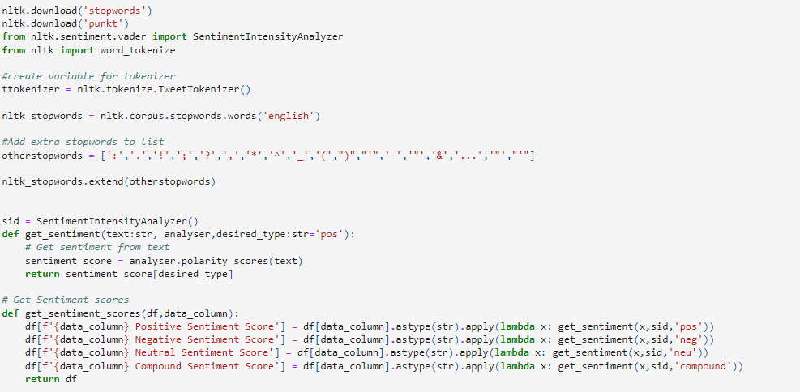
Sentiment Analysis Setup
Removed hyperlinks and mentions but only removed the ‘#’ symbol in order preserve the hashtags’ contextual value
VADER’s SentimentIntensityAnalyzer was applied to all 1000 tweets for each and then placed into a DF for aggregation and descriptive statistics

Slide 7
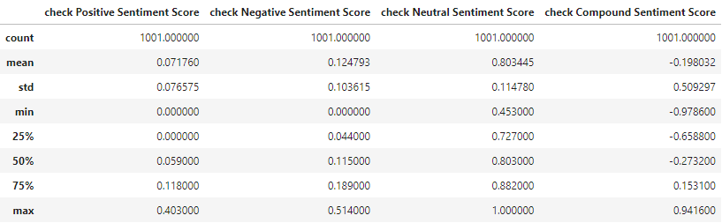
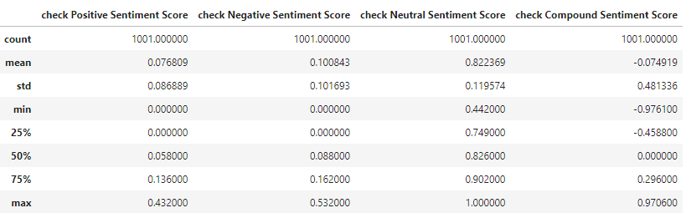
Sentiment Analysis Comparison
Uvalde
Parkland

Slide 8
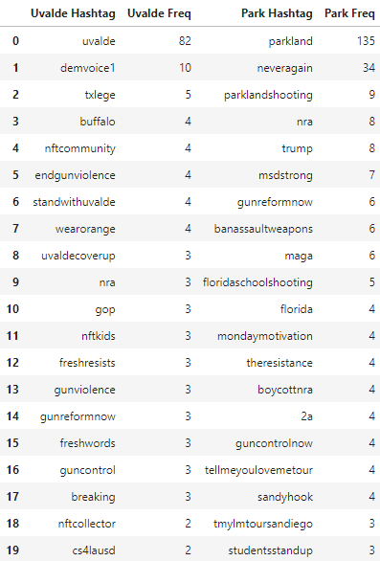
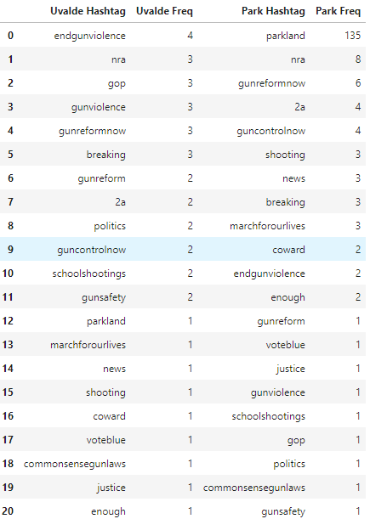
Hashtag Comparison
Hashtags from Parkland are more condensed around the top hashtags
Uvalde shows less instance of the hashtags they have in common
More unrelated hashtags from Uvalde (i.e. #nftcommunity, nftkids,etc)

Slide 9
Conclusion
Uvalde was a more negative average sentiment than Parkland
Mentions and hashtags were more focused towards national politics for Parkland and more localized (state) focused, but with more noise, for Uvalde
Hopefully, this is an indication that the public is becoming more fed up with the continued occurrence of mass shootings but the conversations in the past have yet to see much traction/improvement therefore rather than trying to create reform nationally, the battle over gun rights/control is moving to the more state/local level in hopes of creating some meaningful impact. However, with less cohesion on hashtags along with more noise from Uvalde could signal that the discussions are losing steam and being fragmented by others with ulterior motives.

